Slide 1
Chapter 2: Dot Net Architecture

Slide 2
Learning Objectives
Dot NET Philosophy: CLS, CTS, CLR and MSIL (CIL).
Types in CIL (Value Types V/S Reference Types)
Programming Languages and Platforms supported by Dot NET.
Assemblies and App Domains

Slide 3
Components of Dot NET Platform
.NET Framework
.NET Core
.NET Xamarin
App
Models
WPF
ASP.NET
UWP
IOS
Android
Windows Forms
APS.NET Core
OS X
.NET Standard Library
One Library to rule them all
Common Infrastructure
Compilers
Languages
Runtime Components

Slide 4
1. Common Language Runtime (CLR)
Dot NET Framework provides runtime environment called Common Language Runtime (CLR).It provides an environment to run all the Dot NET Programs.
The code which runs under the CLR is called as Managed Code. Programmers need not worry on managing the memory if the programs are running under the CLR as it provides memory management and thread management.
Programmatically, when our program needs memory, CLR allocates the memory for scope and de-allocates the memory if the scope is completed.
Language Compilers (e.g. C#, VB.NET, F#) will convert the Code/Program to Microsoft Intermediate Language (MSIL) intern this will be converted to Native Code by CLR.
CLR has a Just in Time Compiler that converts the MSIL code into native code when our program is being executed.
CLR also caches the code already converted during execution of managed code, this caching is done only during the lifetime of execution of a managed program.

Slide 5
2. Dot NET Framework Class Library (FCL)
This is also called as Base Class Library and it is common for all types of applications i.e. the way you access the Library Classes and Methods in VB.NET will be the same in C#, and it is common for all other languages in .NET.
The following are different types of applications that can make use of Dot NET class library:
Windows Application.
Console Application
Xamarin Applications
Web Application
XML Web Services
Windows Services
Dot NET standard library the common layer shown as the middleware between the app models and common infrastructure provides a lot of the features and functionality like:
I/O and files.
Graphics
Database
Xml

Slide 6
3. Common Type System (CTS)
It describes set of data types that can be used in different Dot NET languages in common. i.e CTS ensures that objects written in different Dot NET languages can interact with each other.
For Communicating between programs written in any .NET complaint language, the types have to be compatible on the basic level.
The common type system supports two general categories of types:
Value types: Value types directly contain their data, and instances of value types are either allocated on the stack or allocated inline in a structure. Value types can be built-in (implemented by the runtime), user-defined, or enumerations.
Reference types: Reference types store a reference to the value's memory address, and are allocated on the heap. Reference types can be self-describing types, pointer types, or interface types. The type of a reference type can be determined from values of self-describing types. Self-describing types are further split into arrays and class types. The class types are user-defined classes, boxed value types, and delegates.

Slide 7
4. Common Language Specification (CLS)
It is a sub set of CTS and it specifies a set of rules that needs to be adhered or satisfied by all language compilers targeting CLR. It helps in cross language inheritance and cross language debugging.
Common language specification Rules:
It describes the minimal and complete set of features to produce code that can be hosted by CLR. It ensures that products of compilers will work properly in .NET environment.
Sample Rules:
Representation of text strings
Internal representation of enumerations
Definition of static members and this is a subset of the CTS which all .NET languages are expected to support.
Microsoft has defined CLS which are nothing but guidelines that language to follow so that it can communicate with other .NET languages in a seamless manner.
CLS is a large specification of rules that govern the compilation of languages into IL. These rules ensure that the code compiled in different languages is interoperable between different languages.

Slide 8
Evolution of Dot NET Framework

Slide 9
Dot NET Assemblies
An assembly is a collection of types and resources that forms a logical unit of functionality. All types in the .NET Framework must exist in assemblies; the common language runtime does not support types outside of assemblies. Each time you create a Microsoft Windows® Application, Windows Service, Class Library, or other application with Visual Basic .NET, you're building a single assembly. Each assembly is stored as an .exe or .dll file.
Note: Although it's technically possible to create assemblies that span multiple files, you're not likely to use this technology in most situations.
Security: An assembly is the unit at which security permissions are requested and granted. Assemblies are also the level at which you establish identity and trust. The .NET Framework provides two mechanisms for this level of assembly security: strong names and Signcode.exe. You can also manage security by specifying the level of trust for code from a particular site or zone.
Type Identity: The identity of a type depends on the assembly where that type is defined. That is, if you define a type named DataStore in one assembly, and a type named DataStore in another assembly, the .NET Framework can tell them apart because they are in two different assemblies. Of course you can't define two different types with the same name in the same assembly.

Slide 10
Dot NET Assemblies: Continued…
Reference Scope: The assembly is also the location of reference information in general. Each assembly contains information on references in two directions:
The assembly contains metadata that specifies the types and resources within the assembly that are exposed to code outside of the assembly. For example, a particular assembly could expose a public type named Customer with a public property named AccountBalance.
The assembly contains metadata specifying the other assemblies on which it depends. For example, a particular assembly might specify that it depends on the System.Windows.Forms.dll assembly.
Versioning: Each assembly has a 128-bit version number that is presented as a set of four decimal pieces: Major.Minor.Build.Revision.
By default, an assembly will only use types from the exact same assembly (name and version number) that it was built and tested with. That is, if you have an assembly that uses a type from version 1.0.0.2 of another assembly, it will (by default) not use the same type from version 1.0.0.4 of the other assembly. This use of both name and version to identify referenced assemblies helps avoid the "DLL Hell" problem of upgrades to one application breaking other applications.

Slide 11
Dot NET Assemblies: Continued…
Deployment: Assemblies are the natural unit of deployment. The Windows Installer Service 2.0 can install individual assemblies as part of a larger setup program. You can also deploy assemblies in other ways, including by a simple xcopy to the target system or via code download from a web site. When you start an application, it loads other assemblies as a unit as types and resources from those assemblies are needed.
The Assembly Manifest: Every assembly contains an assembly manifest, a set of metadata with information about the assembly. The assembly manifest contains these items:
The assembly name and version
The culture or language the assembly supports (not required in all assemblies)
The public key for any strong name assigned to the assembly (not required in all assemblies)
A list of files in the assembly with hash information
Information on exported types
Information on referenced assemblies
In addition, you can add other information to the manifest by using assembly attributes. Assembly attributes are declared inside of a file in an assembly, and are text strings that describe the assembly. For example, you can set a friendly name for an assembly with the AssemblyTitle attribute.

Slide 12
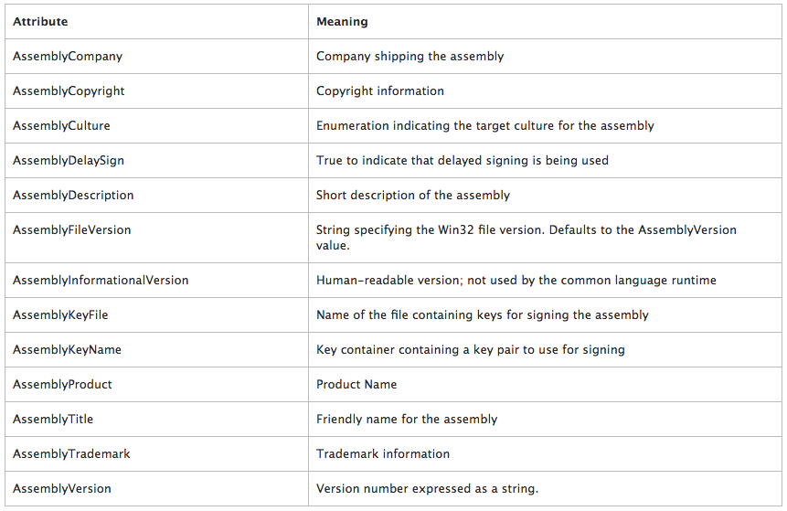
Dot NET Assemblies: Attributes

Slide 13
Global Assembly Cache
Assemblies can be either private or shared.
By default, assemblies are private, and types contained within those assemblies are only available to applications in the same directory as the assembly.
But every computer with the .NET Framework installed also has a global assembly cache (GAC) containing assemblies that are designed to be shared by multiple applications.
There are three ways to add an assembly to the GAC:
Install them with the Windows Installer 2.0
Use the Gacutil.exe tool
Drag and drop the assemblies to the cache with Windows Explorer
Note that in most cases you should plan to install assemblies to the GAC on end-user computers by using the Windows Installer. The gacutil.exe tool and the drag and drop method exist for use during the development cycle.

Slide 14
Application Domains
Operating systems and runtime environments typically provide some form of isolation between applications. For example, Windows uses processes to isolate applications. This isolation is necessary to ensure that code running in one application cannot adversely affect other, unrelated applications.
Application domains provide an isolation boundary for security, reliability, and versioning, and for unloading assemblies. Application domains are typically created by runtime hosts, which are responsible for bootstrapping the common language runtime before an application is run.
The isolation provided by application domains has the following benefits:
Faults in one application cannot affect other applications. Because type-safe code cannot cause memory faults, using application domains ensures that code running in one domain cannot affect other applications in the process.
Individual applications can be stopped without stopping the entire process. Using application domains enables you to unload the code running in a single application.
Code running in one application cannot directly access code or resources from another application.
The behavior of code is scoped by the application in which it runs.
Permissions granted to code can be controlled by the application domain in which the code is running.
IIS uses application domains to run web applications, you can also segregate applications to run under individual processes which are known as app pools.

Slide 15
Application Domains and Assemblies
You must load an assembly into an application domain before you can execute the code it contains. Running a typical application causes several assemblies to be loaded into an application domain.
The way an assembly is loaded determines whether its just-in-time (JIT) compiled code can be shared by multiple application domains in the process, and whether the assembly can be unloaded from the process.
If an assembly is loaded domain-neutral, all application domains that share the same security grant set can share the same JIT-compiled code, which reduces the memory required by the application. However, the assembly can never be unloaded from the process.
If an assembly is not loaded domain-neutral, it must be JIT-compiled in every application domain in which it is loaded. However, the assembly can be unloaded from the process by unloading all the application domains in which it is loaded.
There are three options for loading domain-neutral assemblies:
LoaderOptimization loads no assemblies as domain-neutral, except Mscorlib, which is always loaded domain-neutral.
LoaderOptimization loads all assemblies as domain-neutral.
LoaderOptimization loads strong-named assemblies as domain-neutral, if they and all their dependencies have been installed in the global assembly cache. Other assemblies are loaded and JIT-compiled separately for each application domain in which they are loaded and can be unloaded from the process.

Slide 16
Application Domains and Threads
An application domain forms an isolation boundary for security, versioning, reliability, and unloading of managed code.
A thread is the operating system construct used by the common language runtime to execute code.
At run time, all managed code is loaded into an application domain and is run by one or more managed threads.
There is not a one-to-one correlation between application domains and threads.
Several threads can execute in a single application domain at any given time, and a particular thread is not confined to a single application domain. That is, threads are free to cross application domain boundaries; a new thread is not created for each application domain.
At any given time, every thread executes in an application domain.
Zero, one, or multiple threads might be executing in any given application domain.
The run time keeps track of which threads are running in which application domains.
You can locate the domain in which a thread is executing at any time by calling the Thread.GetDomain method.

Slide 17
Application Domains and Cultures
Culture, which is represented by a CultureInfo object, is associated with threads.
You can get the culture that is associated with the currently executing thread by using the CultureInfo.
CurrentCulture property, and you can get or set the culture that is associated with the currently executing thread by using the Thread.
CurrentCulture property. If the culture that is associated with a thread has been explicitly set by using the Thread.
CurrentCulture property, it continues to be associated with that thread when the thread crosses application domain boundaries. Otherwise, the culture that is associated with the thread at any given time is determined by the value of the CultureInfo.
DefaultThreadCurrentCulture property in the application domain in which the thread is executing:
If the value of the property is not null, the culture that is returned by the property is associated with the thread (and therefore returned by the Thread.CurrentCulture and CultureInfo.CurrentCulture properties).
If the value of the property is null, the current system culture is associated with the thread.

Slide 18
Example: MSIL Code Example
See DNPE-Chapter2 at https://github.com/DotNetTraining/DotNetEssentials/tree/master/Code/DNPE/DNPE-Chapter2

Slide 19
Thank You !

